Slide 1
Signals and Systems
Lecturer:
Dr. Bin Xia
Dept. of Electronic Engineering
Shanghai Jiao Tong University
Chapter 7: z Transform

Slide 2
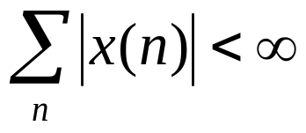
Foreword of the Chapter
DT Fourier transform enables us to do a lot of things, e.g.
  Analyze frequency response of LTI systems
  Modulation …
Why do we need yet another transform?
  One view of Laplace Transform is as an extension of the Fourier transform to allow analysis of broader class of signals and systems
  In particular, Fourier transform cannot handle large (and important) classes of signals and unstable systems, i.e. when can not meet.

Slide 3



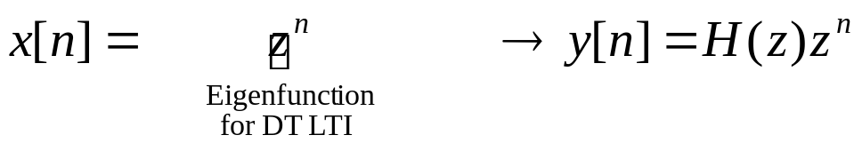
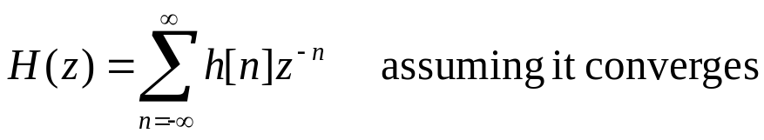
How do we analyze such signals/systems? Recall the eigenfunction property of LTI systems:
  z^{n} is an eigenfunction of any DT LTI system
  We now do not restrict ourselves just to z = e^{jω}

Slide 4
Outline of the Chapter
7.1 (Bilateral) z Transform
7.2 Properties of RoCs
7.3 z Transform Properties
7.4 Inverse z Transform
7.5 Analysis of LTI Systems using the zT
7.6 Unilateral z Transform and Applications

Slide 5
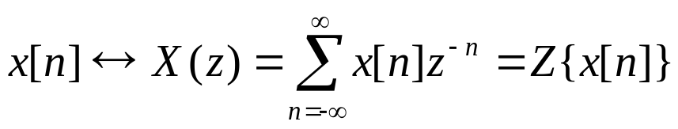
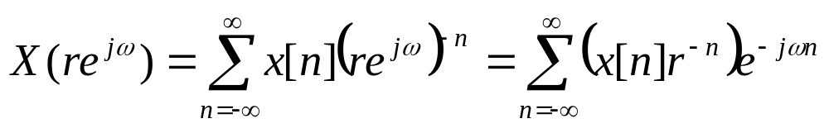
z is a complex variable – Now we explore the full range of z
Basic ideas
Express the complex variable z in polar form as z=re^{jω}
(1) X(re^{jω}) is the Fourier transform of x[n] multiplied by a real exponential r^{-n}, if it exists.
(2) For r=1, the z transform reduces to the Fourier transform.
7.1.1 The (Bilateral) z Transform

Slide 6
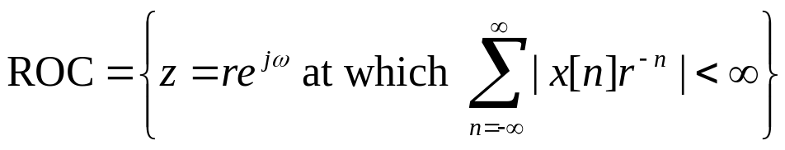
(3) In general, the z transform of a sequence has associated it with a range of values of z for which X(z) converges, and this range of values is referred to as the region of convergence (ROC)
(4) If the RoC includes the unit circle, then the Fourier transform also converges
—depends only on r = |z|, just like the ROC in s-plane only depends on Re(s)

Slide 7

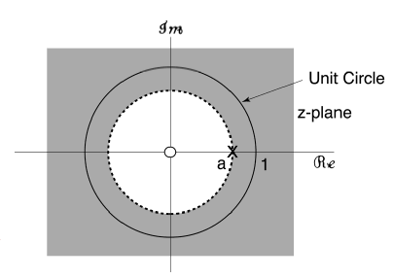
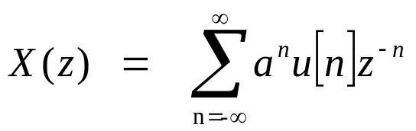
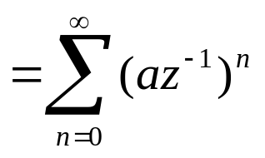
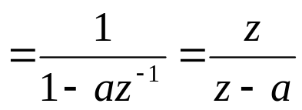
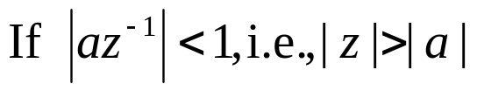
Example 1:
(a – an arbitrary real or complex number)
  This form for PFE and inverse z- transform
This form to find
pole and zero locations
That is, ROC |z| > |a|, outside a circle

Slide 8
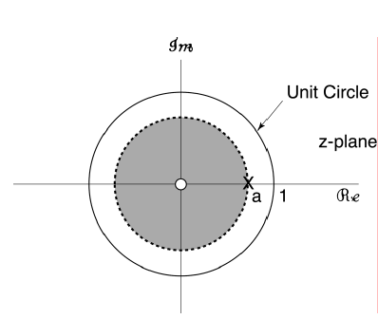

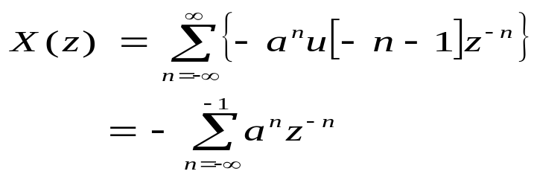
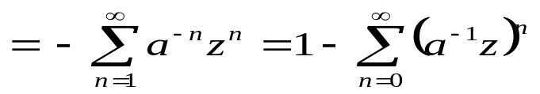
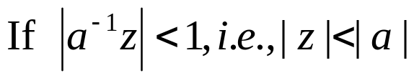
Example 2:
Same as X(z) in previous example, but different ROC
Key Point (and key difference from FT): Need both X(z) and ROC to uniquely determine x[n].
No such an issue for FT.

Slide 9
7.1.2 Graphical Visualization of the ROC
Example1 Example2

Slide 10
7.1.3 Rational Transforms
Many (but by no means all) z transforms of interest to us are rational functions of s (e.g., Example 1 and 2; in general, impulse responses of LTI systems described by LCCDEs), where
X(z) = N(z)/D(z), N(z),D(z) – polynomials in z
Roots of N(z)= zeros of X(z)
Roots of D(z)= poles of X(z)
Any x[n] consisting of a linear combination of complex exponentials for n > 0 and for n < 0 (e.g., as in Example #1 and #2) has a rational z transform.
Except for a scale factor, a complete specification of a rational z transform consists of the pole-zero plot of the transform, together with its RoC

Slide 11
Outline of the Chapter
7.1 (Bilateral) z Transform
7.2 Properties of RoCs
7.3 z Transform Properties
7.4 Inverse z Transform
7.5 Analysis of LTI Systems using the zT
7.6 Unilateral z Transform and Applications

Slide 12
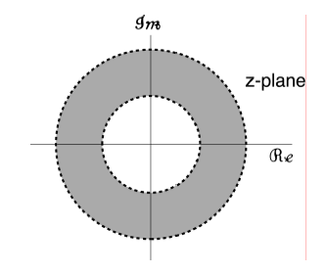
— depends only on r = |z|
1) Property 1: The ROC of X(z) consist of a ring in the z-plane centered about the origin
Proof: In order to make the F.T of x[n]r^{-n} converged, it should be absolutely summable, i.e. the RoC only depends on the radius of z
2) Property 2: The ROC does not contain any poles. If X(z) is rational, then its ROC is bounded by poles or extends to infinity.

Slide 13
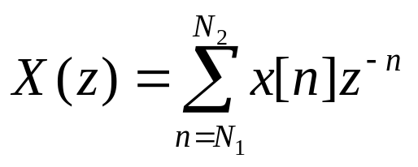
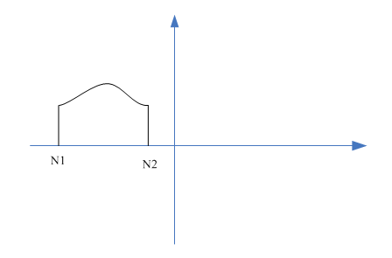

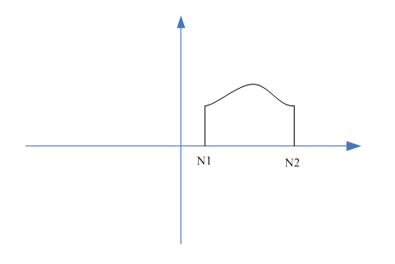

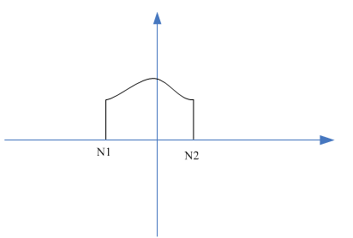
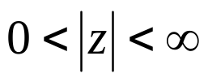
3) Property 3: If x[n] is of finite duration, then the ROC is the entire z-plane, except possibly z=0 and/or z=∞
when N1<N2<0, the RoC is the entire z-plane, excluding z=∞:
That’s
when N2>N1>0, the RoC is the entire z-plane, excluding z=0
That’s
when N1<0,N2>0, the RoC is the entire z-plane, excluding z=0 and z=∞, that’s

Slide 14
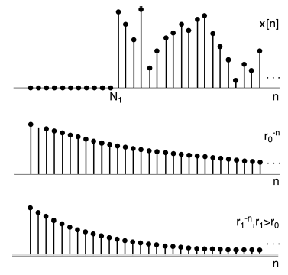
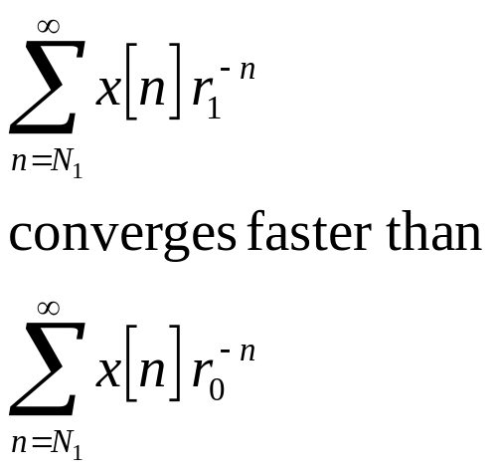
4) Property 4: If x[n] is a right-sided sequence, and if |z| = r₀ is in the ROC, then all finite values of z for which |z| > r₀ are also in the ROC.

Slide 15
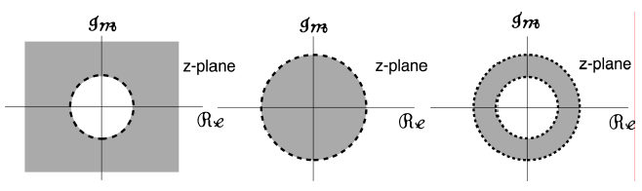
5) Property 5: If x[n] is a left-sided sequence, and if |z| = r₀ is in the ROC, then all finite values of z for which 0 < |z| < r₀ are also in the ROC.
6) If x[n] is two-sided, and if |z| = r₀ is in the ROC, then the ROC consists of a ring in the z-plane including the circle |z| = r₀.
What types of signals do the following ROC correspond to?
right-sided left-sided two-sided

Slide 16

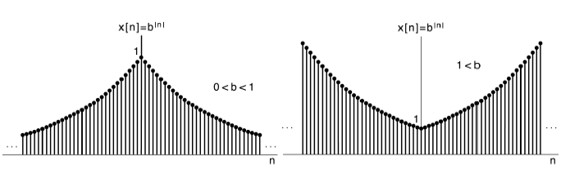

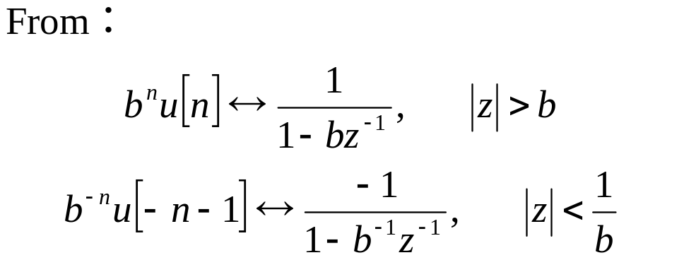
Example:

Slide 17
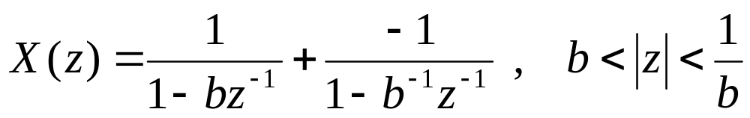
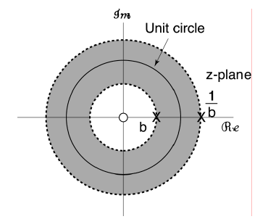
Clearly, ROC does not exist if b > 1 ⇒ No z-transform for b^{|n|}.

Slide 18
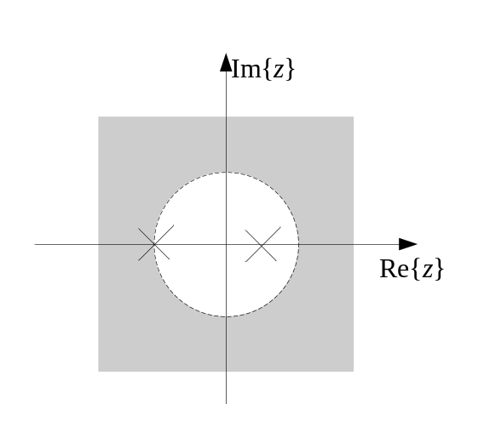
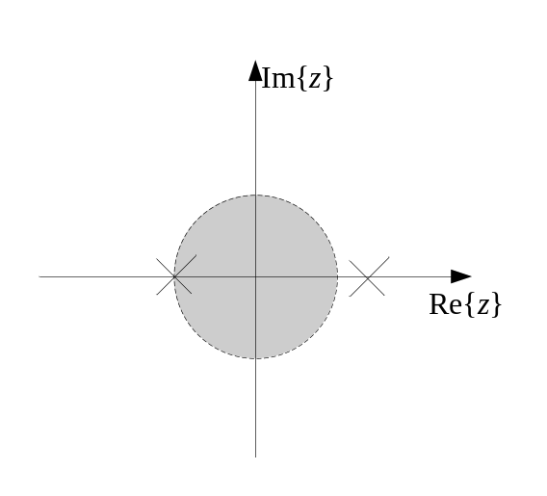
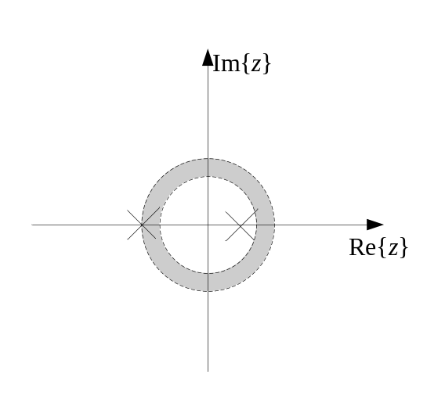
7) If X(z) is rational, then its ROC is bounded by poles or extends to infinity. In addition, no poles of X(z) are contained in the ROC.
8) Suppose X(z) is rational, then
(a) If x[n] is right-sided, the ROC is to the right of the outermost pole.
(b) If x[n] is left-sided, the ROC is to the left of the innermost pole.
9) If ROC of X(z) includes the unit circle, then FT of x[n] exists.

Slide 19
Outline of the Chapter
7.1 (Bilateral) z Transform
7.2 Properties of RoCs
7.3 z Transform Properties
7.4 Inverse z Transform
7.5 Analysis of LTI Systems using the zT
7.6 Unilateral z Transform and Applications

Slide 20
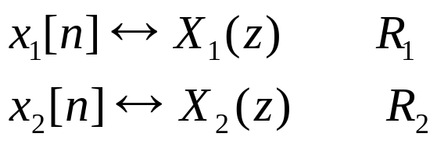

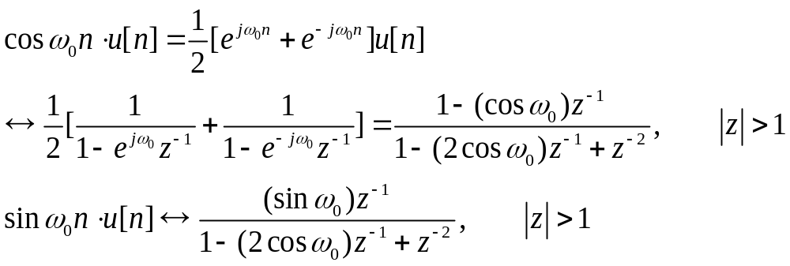
Linearity
RoC contains the intersection of R₁ and R₂, which may be empty, also can be larger than the intersection
Example：

Slide 21

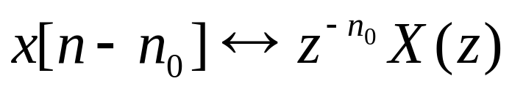

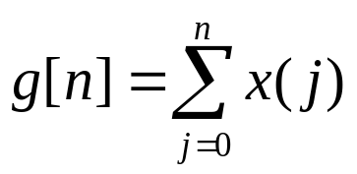
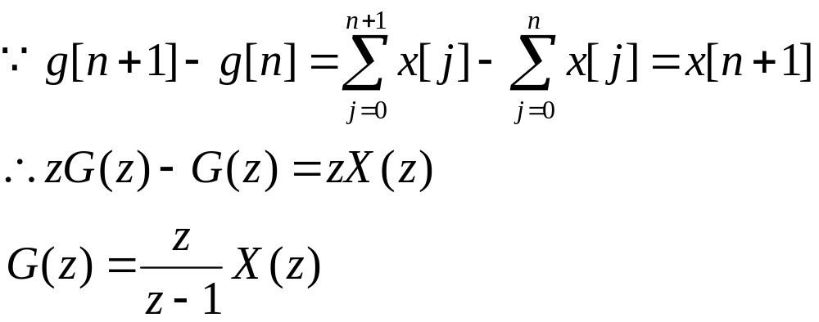
Time Shift
RoC=R, except for the possible addition or deletion of the origin or infinity.
Example： suppose
To determine the z transform of the following signal:
ROC of G(z) is that of X(z), excluding z=1
But if z=1 is zero(s) of X(z), the RoC of G(z) is identical to that of X(z)

Slide 22
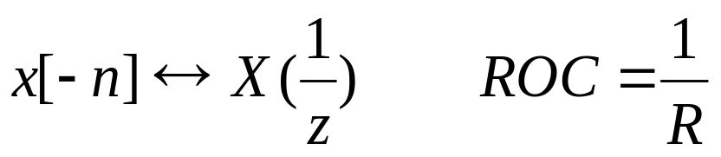

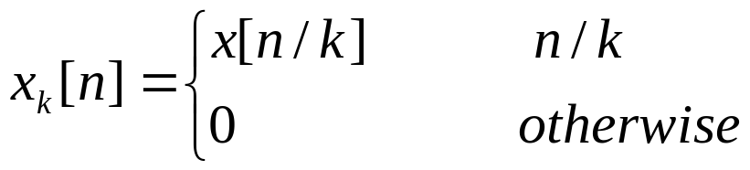
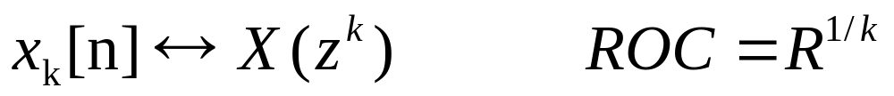
Time Reversal
Time Expansion
for
is integral
then

Slide 23
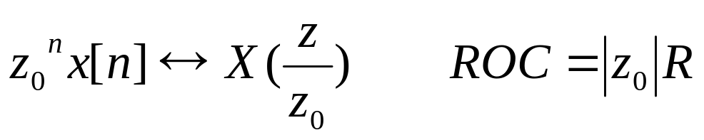
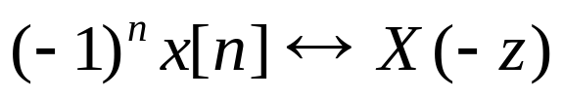
Scaling in the z_Domain
Special case:
Example：

Slide 24

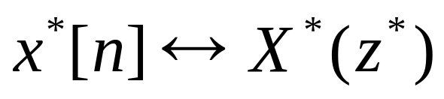
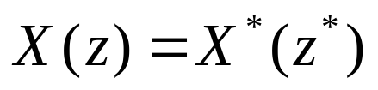
Conjugation
Consequence, if x[n] is real, then
Thus, if X(z) has a pole/zero at z=z₀, it must also have a pole/zero at the complex conjugation point z=z₀*

Slide 25
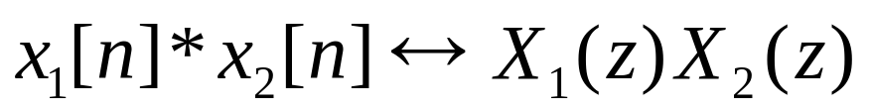
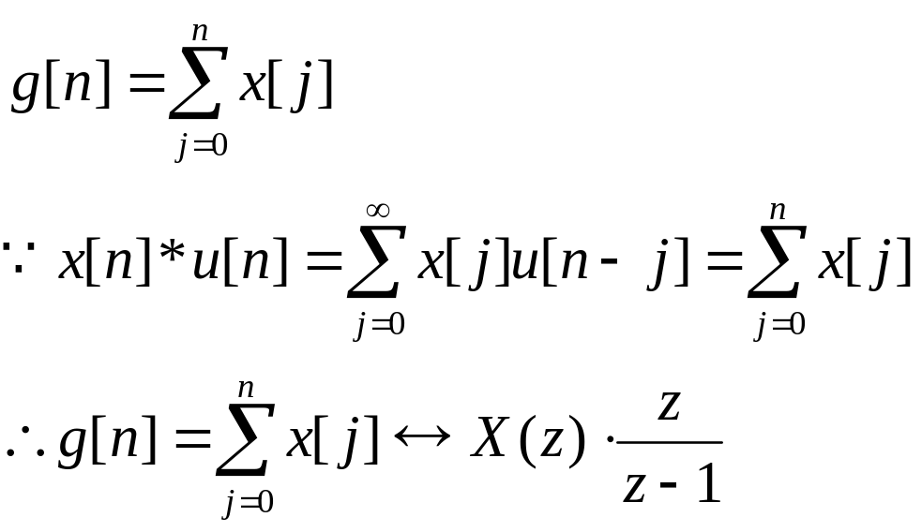
The Convolution Property
ROC contains the intersection of R₁ and R₂, which may be empty, also can be larger than the intersection
Example:

Slide 26
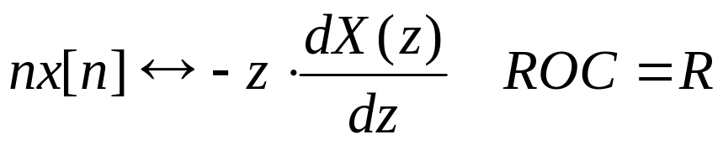
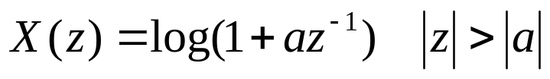

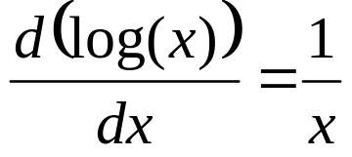
Differentiation in the z Domain
Example：
If
Determine x[n]
Let
Then following

Slide 27
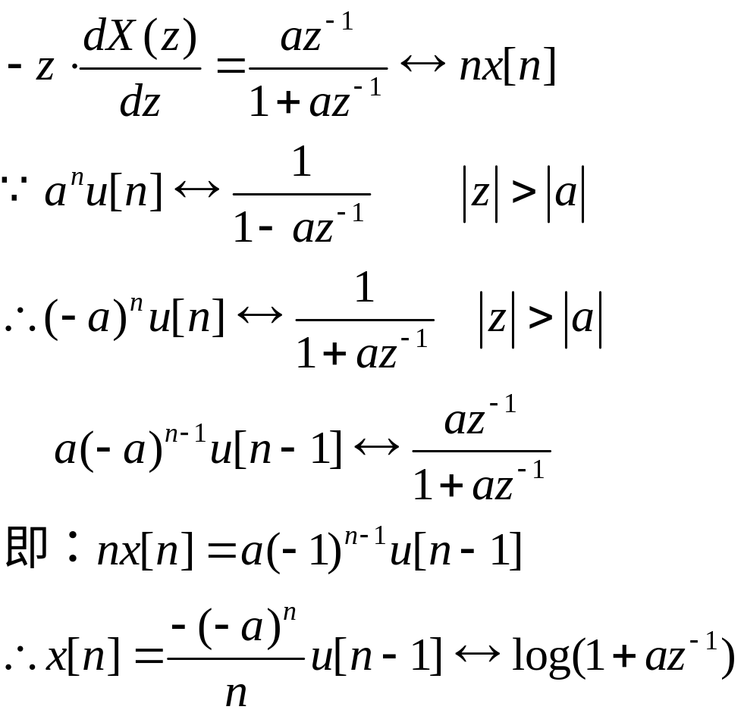
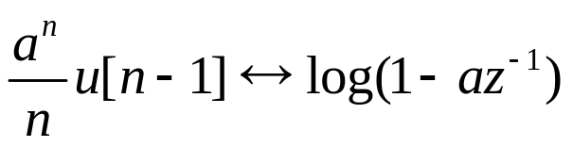
Similarly:
thus

Slide 28


The Initial-Value Theorem
If x[n] is a casual sequence, i.e. when n<0, x[n]=0, then
Hints to prove the initial-value theorem:
according to the definition of the Z transform
Final-value theorem
If x[n] is a casual sequence, i.e. when n<0, x[n]=0, and the RoC contains the unit circle, then
Hints to prove the final-value theorem:
Z{x(n+1)-x(n)}=Z{x(n+1)}-Z{x(n)}
=z(X(z)-x(0))-X(z)
and rewrite Z{x(n+1)-x(n)} according to the definition of the Z Transform

Slide 29
Outline of the Chapter
7.1 (Bilateral) z Transform
7.2 Properties of RoCs
7.3 z Transform Properties
7.4 Inverse z Transform
7.5 Analysis of LTI Systems using the zT
7.6 Unilateral z Transform and Applications

Slide 30





7.4.1 The Inverse z Transform
for fixed r:
-Inverse z Transform
We should choose any value of r in the RoC to make the integration converged

Slide 31
  The symbol O denotes the integration around a counterclockwise circular contour centered at the origin and with radius r.
  The inverse z transform equation states that x[n] can be represented as a weighted integral of complex exponentials
  The formal evaluation of the integral for a general X(z) requires the use of contour integration (围线积分） in complex plane
  There are two alternatives to obtain a sequence from its z transform:
    Partial fractional expansion:
    Power series expansion:
√

Slide 32


Informative
Contour Integration Method
Where C is the counterclockwise circular contour centered at the origin and within the ROC of X(z),
z_{m} is the pole of X(z)z^{n-1} at the left-hand side of C.
If z_{m} is the s-th order pole of X(z)z^{n-1}, then

Slide 33

Example:

Slide 34





（1）when |z|>2, x[n] is a causal sequence,
Let
As shown in the figure, the poles at the left-hand side of C are
Then
Thus:

Slide 35





（2）
When 1/3<|z|<2, x[n] is a double-side sequence
when
, there is one pole at the left-hand side of C:

Slide 36




When n=-1,
Both of them are 1st order poles
The poles at the left-hand side of C are
and

Slide 37




When n=-2,
At the left-hand side of C, besides the 1st order pole
, there is a 2nd order pole:
Similarly, when n=-3,
In summary,

Slide 38



For n<0, in order to avoid calculating the residual at z=0, we can calculate the contour integration along the clockwise circular contour C’, which is centered at the origin and within the ROC of X(z)
z_{m} the pole of X(z)z^{n-1} at the left-hand side of C’, i.e. the right-hand side poles of C
As in the previous example, when n<0, there is only one pole at the right-hand side of C: z=2, then

Slide 39






（3）
When |z|<1/3, x[n] is a anti-causal sequence
As shown in the figure , z=0 is the n-th order pole at the left-hand side of C, whereas the poles at the right-hand side of C are
Then

Slide 40



PFE (Partial fractional expansion) Method
Suppose
It has M 1st order poles at
And a s-th order pole at

Slide 41






where
Notes:

Slide 42




Example：
B1, B2, B3=1，4，16

Slide 43





Substituting
in X(z)
Equating coefficients, one obtains
Then

Slide 44





Power-Series Expansion
1. X(z) is irrational:
Example：

Slide 45



2. X(z) is rational,
Performing long division approach to obtain a power series of z for X(z), the coefficients in this power series are the sequence of x[n].
（1）
is a right-sided sequence, arrange the numerator and denominator with a order of the power of z decreasing
（2）
is a left-sided sequence, arrange the numerator and denominator with a order of the power of z increasing

Slide 46






Example:
Let
Notes: Power-series expansion may come to open/infinity expression

Slide 47
Outline of the Chapter
7.1 (Bilateral) z Transform
7.2 Properties of RoCs
7.3 z Transform Properties
7.4 Inverse z Transform
7.5 Analysis of LTI Systems using the ZT
  7.6 Unilateral z Transform and Applications
W15.1

Slide 48





7.5.1 DT System Function
  Y(z) = H(z)X(z) , ROC at least the intersection of the ROCs of H(z) and X(z),
  can be bigger if there is pole/zero cancellation. e.g.
H(z) + ROC tells us everything about system

Slide 49





7.5.2 CAUSALITY
(1) h[n] right-sided⇒ROC is the exterior of a circle possibly
  including z = ∞:
No z^{m} terms with m>0
=>z=∞
ROC
A DT LTI system with system function H(z) is causal ⇔ the ROC of
H(z) is the exterior of a circle including z = ∞

Slide 50



Causality for Systems with Rational System Functions
A DT LTI system with rational system function H(z) is causal
⇔ (a) the ROC is the exterior of a circle outside the outermost pole;
and (b) if we write H(z) as a ratio of polynomials
then

Slide 51

7.5.3 Stability
  LTI System Stable⇔ ROC of H(z) includes
  the unit circle |z| = 1
⇒ Frequency Response H(e^{jω}) (DTFT of h[n]) exists.
  A causal LTI system with rational system function is stable ⇔ all poles are inside the unit circle, i.e. have magnitudes < 1

Slide 52






Example:
×
×
Determine h[n], and the causality and stability of the system
（1）
Causal, unstable
（2）
Non-causal, unstable
（3）
Non-causal, stable

Slide 53



7.5.4 LTI Systems Described by LCCDEs
Use the time-shift property
—Rational
ROC: Depends on Boundary Conditions, left-, right-, or two-sided.
For Causal Systems ⇒ ROC is outside the outermost pole

Slide 54


System Function vs Difference Equation
Suppose when the input is
the zero-state response of the system is
To determine h[n] and the difference equation of the system

Slide 55






（1）

Slide 56


（2）
—前向差分
Or:
—后向差分

Slide 57



Example: The input-output relationship in time domain for the causal system could be represented by a 2nd order const-coefficient difference equation, if the input is
The system response (zero state response) is
then
(1) If the system is with zero-initial state, determine the 2nd order difference equation
(2) If the initial state of the system is y[-1]=1,y[-2]=2, determine the zero-input response of the system with the 2nd order difference equation obtained in step 1
(3) If the initial state of the system is y[-1]=2,y[-2]=4,, the input is ，, determine the full response of the system y[n]

Slide 58

(1)

Slide 59


(2)
The characteristic values are
Then zero-input response can be
Substituting
in
Then

Slide 60

(3)
Since the system could be described by a 2nd order LCCDE, it is an LTI system, satisfying linear zero-input, and linear zero-state properties:
when
,
when
,

Slide 61



Example: For an LTI system, the initial condition is 0
(a) For any n, when
, y[n]=0
(b) when
,
Determine：
(1) the coefficient a,
(2) When for all n, x[n]=1, determine y[n]

Slide 62




(1)
when
then
（2）when x[n]=1

Slide 63
Outline of the Chapter
7.1 (Bilateral) z Transform
7.2 Properties of RoCs
7.3 z Transform Properties
7.4 Inverse z Transform
7.5 Analysis of LTI Systems using the ZT
7.6 Unilateral z Transform and Applications

Slide 64



7.6.1 Unilateral z-Transform (UZT)
Note:
Differs from BZT
(1) If x[n] = 0 for n < 0, then
  UZT of x[n] = BZT of x[n]u[n]⇒ROC always outside a circle
  and includes z = ∞
(3) For causal LTI systems,
(4) The calculation of the inverse UZT is basically the same as that for BZT, with the constraint that the RoC for a UZT must always be the exterior of a circle.

Slide 65



  7.6.2 Properties of Unilateral z-Transform
Many properties are analogous to properties of the BZT e.g.
Convolution property (for x₁[n<0] = x₂[n<0] = 0)
But there are important differences. For example, time-shift
UZ
Derivation:
Initial condition

Slide 66




More general
UZ
UZ
UZ
Proof：

Slide 67



  7.6.3 Use of UZTs in Solving Difference Equations with Initial Conditions
For an LSI system
Assume x[n]=0 when n<0, the initial condition of the system is {y(-1),y(-2),…,y(-n)}, then
Zero-input response
Zero-state response

Slide 68




Example:
UZT of Difference Equation
ZIR — Output purely due to the initial conditions,
ZSR — Output purely due to the input.

Slide 69



β = 0 ⇒ System is initially at rest:
ZSR
α = 0 ⇒ Get response to initial conditions
ZIR

Slide 70


Example：
with y[-1]=2，y[-2]=-1/2 x[n]=u[n]
determine

Slide 71




Substituting y[-1]=2,y[-2]=-1/2, and
In Y(z), one obtains

Slide 72
Homework
  BASIC PROBLEMS WITH ANSWER: 10.13
  BASIC PROBLEMS: 10.21, 10.23, 10.34, 10.36, 10.42(a)
  ADVANCED PROBLEMS: 10.46

Slide 73
Outline of the Chapter
7.1 (Bilateral) z Transform
7.2 Properties of RoCs
7.3 z Transform Properties
7.4 Inverse z Transform
7.5 Analysis of LTI Systems using the ZT
7.6 Unilateral z Transform and Applications
W16.1

